Slide 1
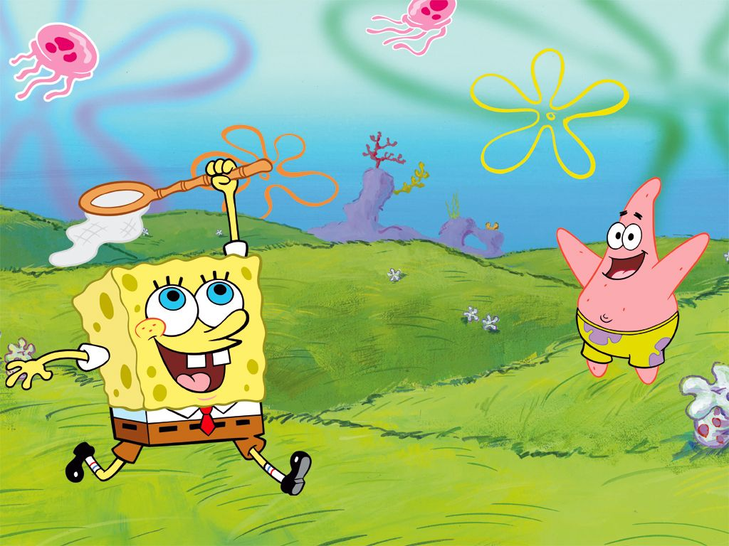




Slide 2
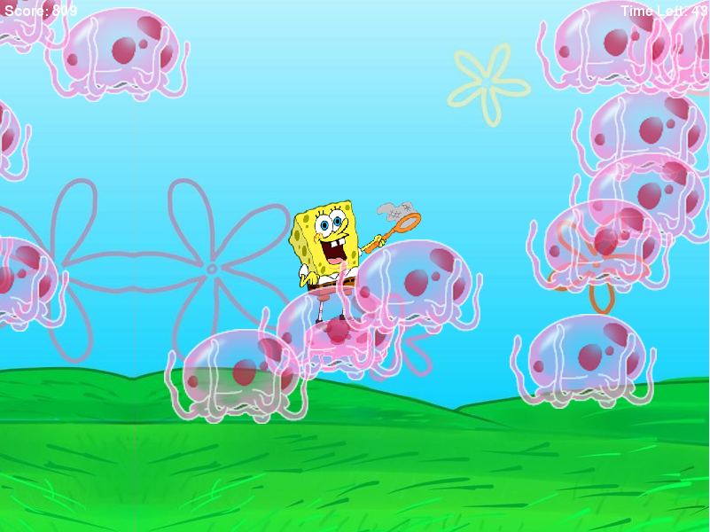
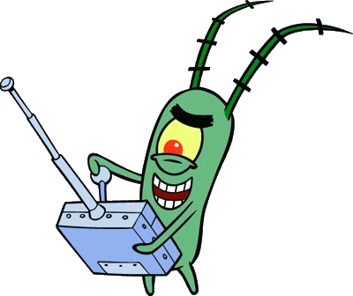

Slide 3
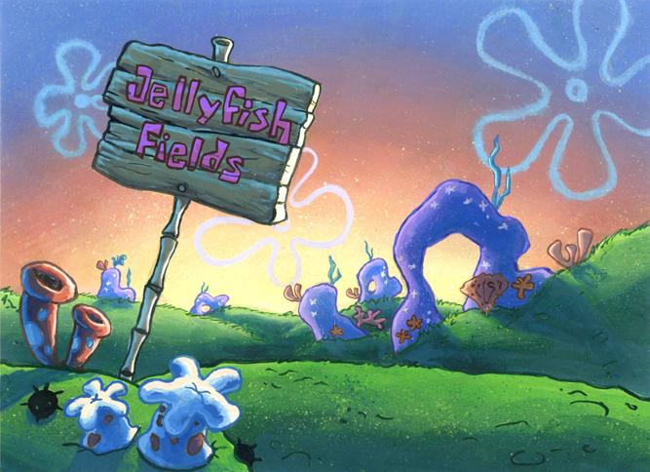
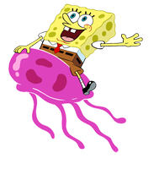



Slide 4
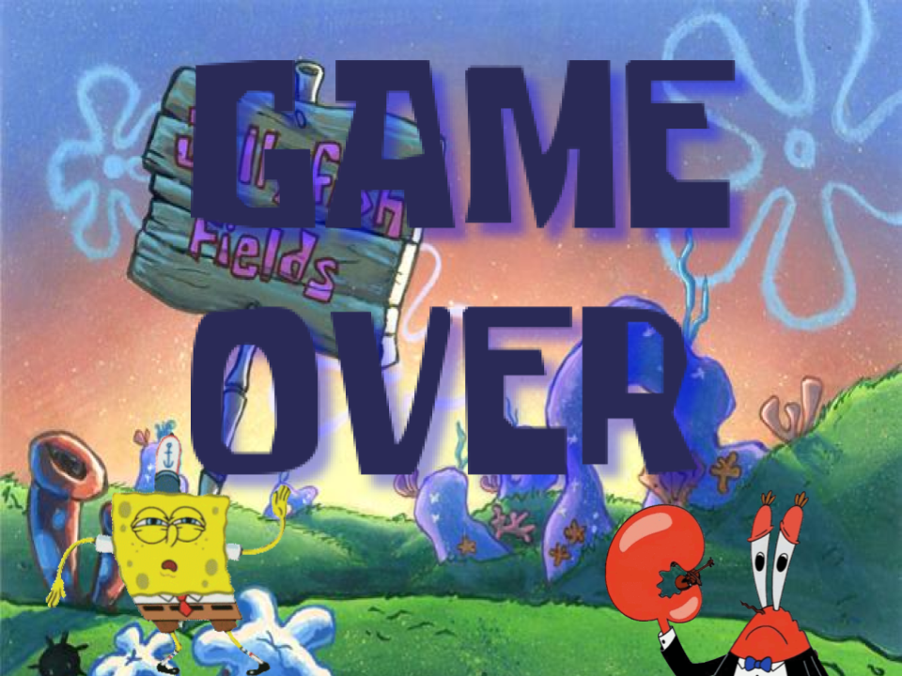

Slide 5
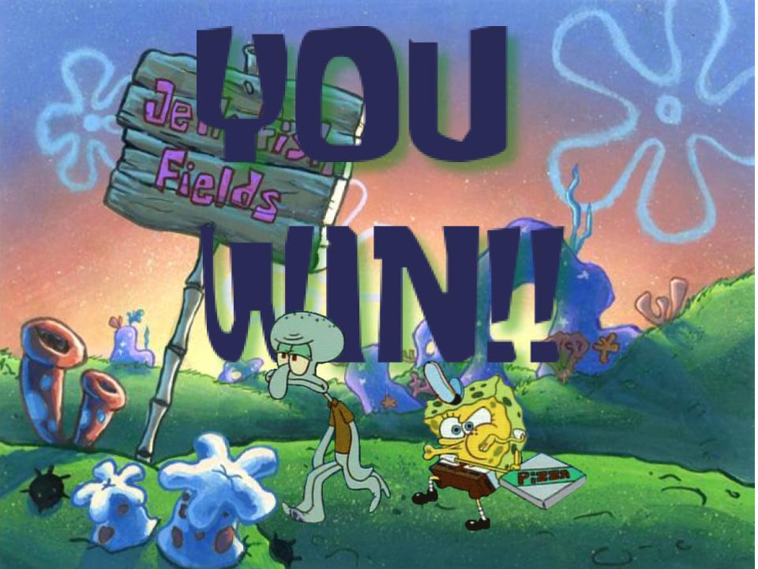

Slide 6
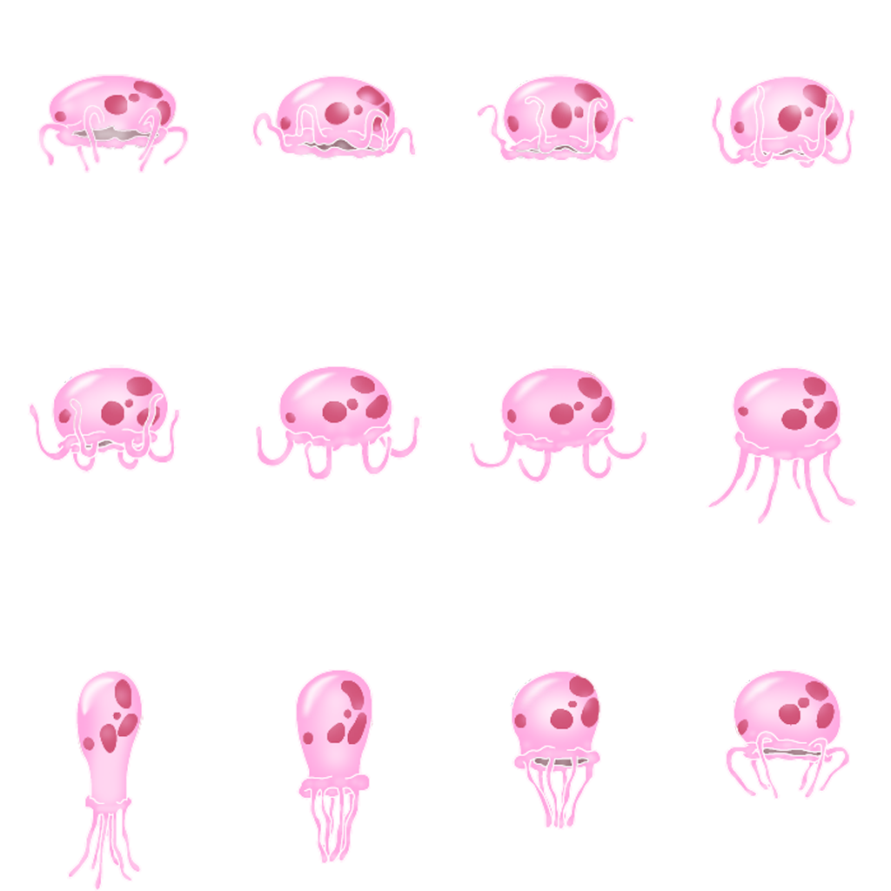

Slide 7
Win/lose
You win if you catch all the jellyfish before the time runs out.
You lose by not collecting enough jellyfish in time

Slide 8
Interactions
Up
Left Right
Down

Slide 9
Challenges
Plankton will move across the screen and decrease the score

Slide 10
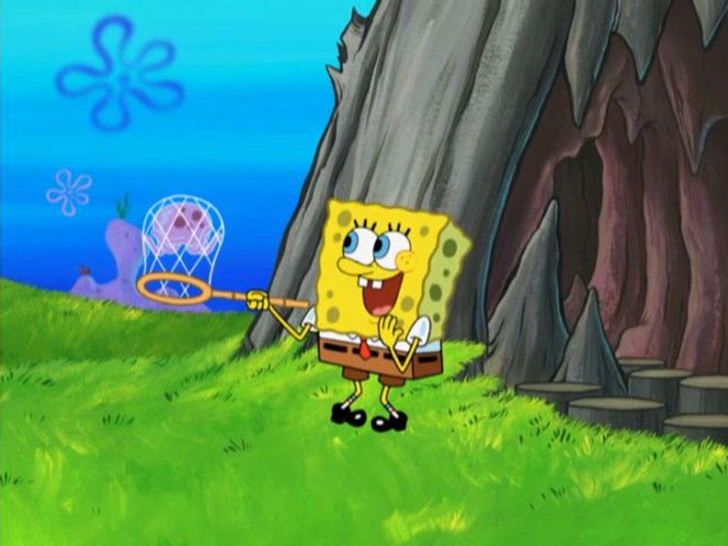
Objective
Help Spongebob catch all the jellyfish before the time runs out.

Slide 11
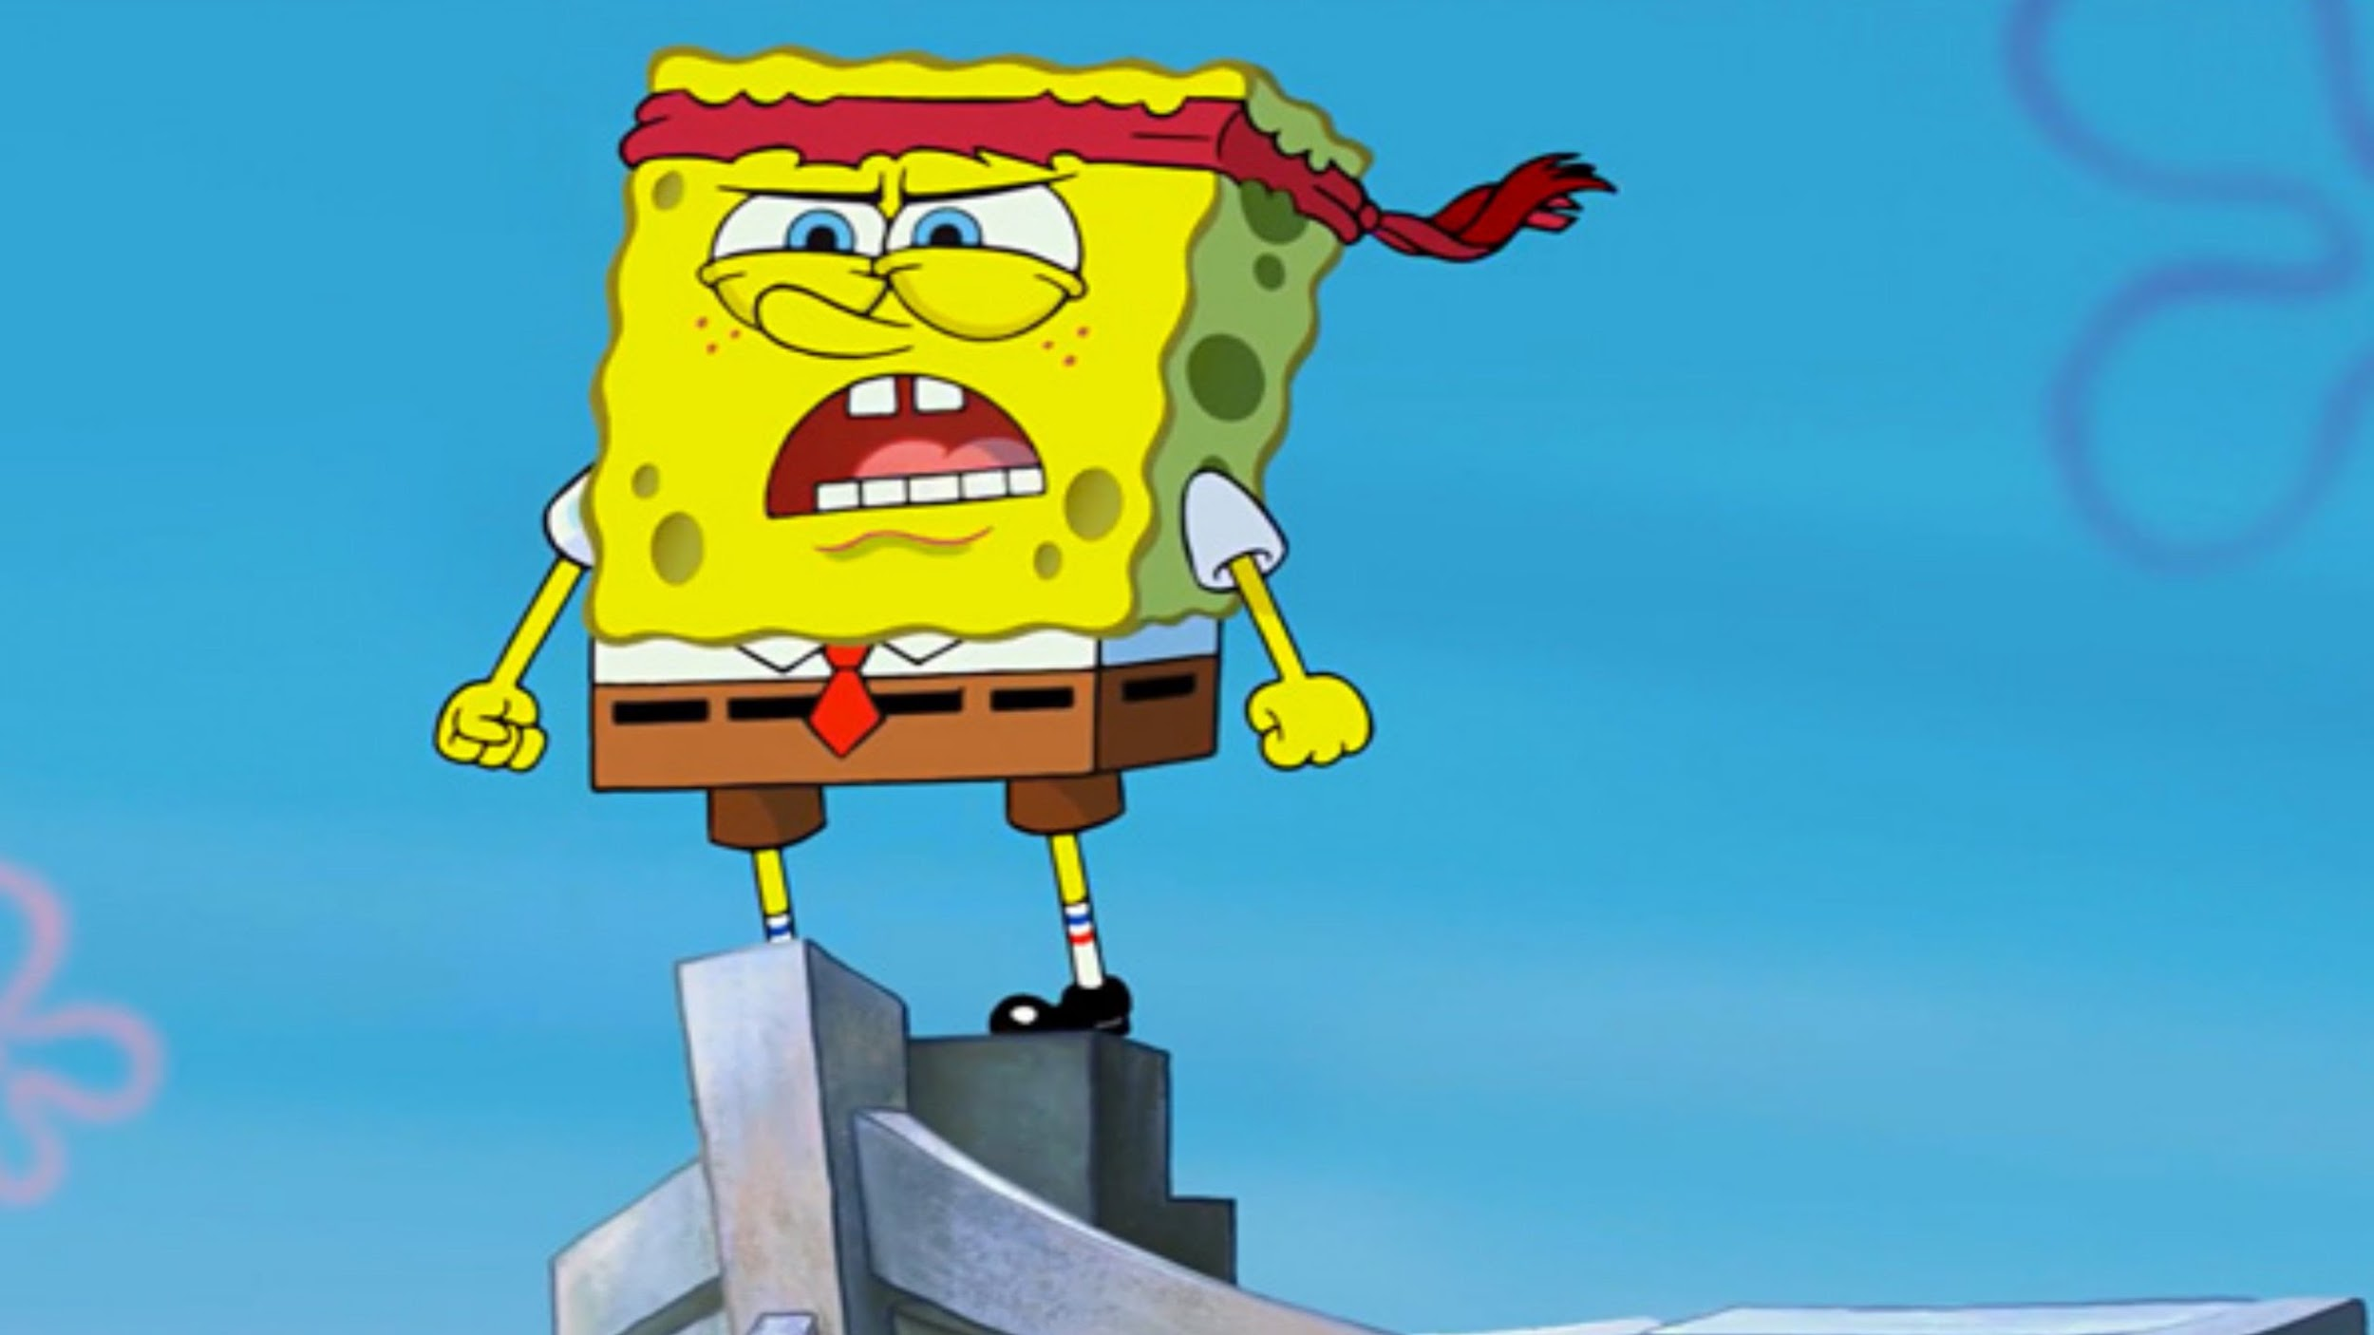
characters
Notes:
Characters
Spongebob and patrick

